Slide 1
Identity and Access Management
Group 8
Presented by: Preet Patel, Tiwaloluwa Ojo, Waleed El Alawi, Aaditya Rajput

Slide 2
Project Motivation
The motivation behind this project is to implement a last line of defense to limit the amount of damage to a system when the security of the application is compromised.
The project should involve creating a system to prevent unauthorized users from accessing sensitive data or performing actions in the system that require higher level of security clearance.
Notes:
For this project, we wanted to create a last line of defense for a system when a user’s login information is compromised and also to create a system to prevent lower privileged users from access sensitive data.

Slide 3
What is IAM?
Identity and Access Management (IAM) is a framework of business processes, policies, and technologies that facilitates the management and access to digital intellectual property based on digital identity.
The use of IAM allows the system to prevent the risk of any internal attacks where a user is attempting to access information they are not authorized to and prevent the risk of users attempting to commit actions they are not authorized to.
Notes:
IAM is a security measure that implements access control based on user identity. It allows the system to prevent the risk of any internal attacks where a lower privileged user is attempting to access information or perform actions they are not authorized to.

Slide 4
Project Aim
The purpose of this project is to build a Role Based Access Control (RBAC) IAM framework for a Web Forum Application.
The Forum application will use APIs to function and these will require users to have valid permissions to be able to call these APIs to perform various actions in the application.
Various tools and frameworks such as a relational database, framework for creating the web server, and a framework for implementing the user interface.
The deliverables for this project will consist of a Backend API service, a database, and an user interface.
Notes:
For this project we will be creating a IAM system that implements role based access control in an example forum application. We will be utilizing various tools, frameworks and a relational database to implement our project.

Slide 5
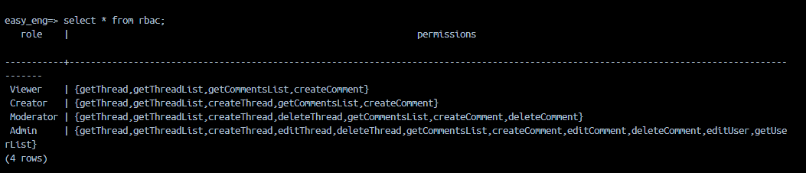
Project Implementation details
Access Matrix - Contains details regarding the roles in the system and the different permissions that each roles contains in the system. It can be implemented using a relational database.
Notes:
Next we will look at the methodology we used to implement role based access control in a forum application. The first and most crucial component of implementing role based access control is an access matrix which contains the details of all the roles in the system and the API permissions for each of the roles.

Slide 6
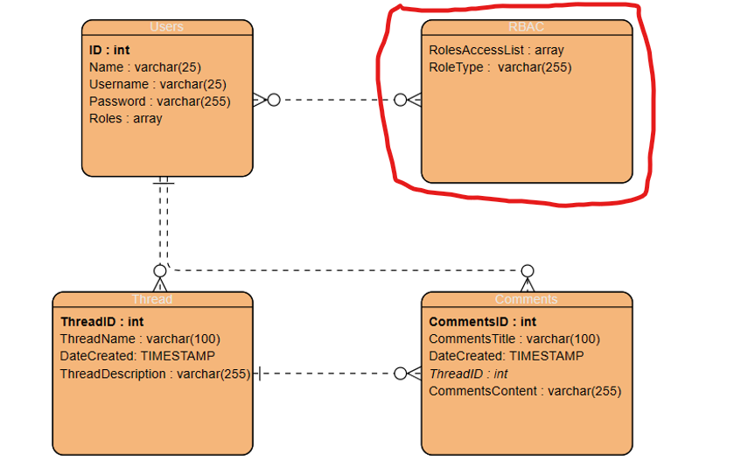
Entity Relationship Diagram - Database Structure
Notes:
This, is our database structure where we are storing the access matrix in the circled rbac table. We also have the users table that holds all the user data, thread and comments tables that contain all the forum application data.

Slide 7
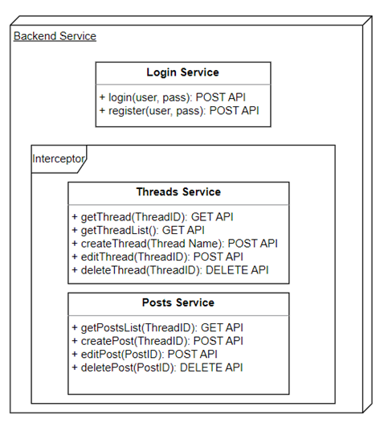
Project implementation details
Forum Application Backend Server - Contains all the API endpoints that will be used to implement the forum application and the request interceptor that will prevent unauthorized users from accessing APIs that can perform certain actions that require higher level of privileges.
Notes:
Next, we have the backend web server where we have implemented the following 3 services that implement different business logic for the application. The main component for the role based access control is the request interceptor component that will intercept any API requests and check if the user has permission to make that request. Also the login service APIs is not covered as it should be accessible to anyone on the internet to authenticate themselves before interacting with the other APIs of our application.
Next,
Aaditya will talk about the structure of our system and will show an example for how an API request is handled.

Slide 8
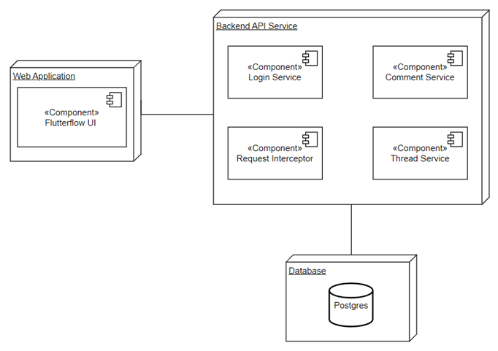
Deployment Diagram - Forum Application
Notes:
We used model view controller architecture in our application which allowed us to separate the front end and backend into different components so it would be easier to code and debug one without breaking the other. In this deployment diagram you can see all the components to our application. As you can see the front end of the web app is created using flutterflow ui. The front end communicates to our backend via api requests. Our server, build with the springboots framework responds to the requests from the front end by querying our postgresql database hosted on the cloud.

Slide 9
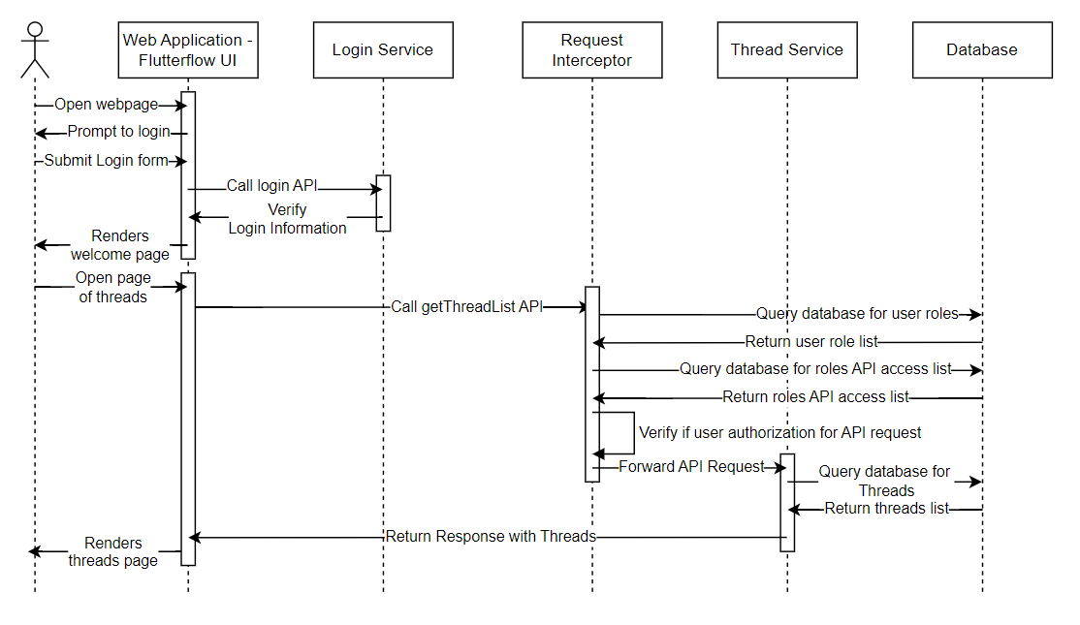
Sequence Diagram - Example
Notes:
This is our sequence diagram. As you can see the user opens the webpage and attempts to login which sends a login api request to the backend. After the user can attempt to do other actions which awakes the interceptor on our springboots framework. The interceptor intercepts the api request and verifies if the user can commit that action based on their role by querying the postgresql db. If not the cannot commit the action. If they are authorized then the api request goes through and returns the user to the action they want to commit.

Slide 10
Demo - Results and Evaluation

Slide 11
Conclusion
In conclusion, our team has successfully developed an Identity and Access Management (IAM) framework using RBAC rules for a web forum application designed in FlutterFlow CMS and Spring Boot.
FlutterFlow allowed us to create an intuitive and efficient way to create the frontend whereas Spring Boot and PostgreSQL database allowed us to create the backend of the application.
Our Project has achieved its objectives, which included creating a secure role-based access system and a simple forum webpage to display threads and comments. Additionally, our project has demonstrated how the use of modern development tools and frameworks can simplify the development process and increase productivity.

